Slide 1
Employment Equity
Anne Génard
Andy Guerrier
Christian Lubin
Yassine Sarifuddin

Slide 2
Encouraging trends
Even though Men are still more represented in the higher salary brackets, the % of Women in higher pay bracket is increasing.
% of Women | 1997 | 1998 | 1999 | 2000 | 2001 | 2002 | 2003 | 2004 | 2005 | 2006 | 2007 | 2008 | 2009 | 2010 | 2011 | 2012 | 2013 | 2014 | 2015 | 2016 | 2017 | 2018 | 2019
$100,000 and over | 14% | 16% | 17% | 19% | 20% | 20% | 20% | 21% | 21% | 22% | 23% | 23% | 24% | 23% | 24% | 24% | 25% | 26% | 27% | 27% | 27% | 27% | 27%
50-100K | 22% | 23% | 24% | 26% | 28% | 28% | 29% | 29% | 31% | 33% | 33% | 34% | 35% | 34% | 35% | 36% | 36% | 36% | 37% | 37% | 37% | 37% | 37%
25-50K | 49% | 49% | 49% | 49% | 51% | 51% | 51% | 50% | 50% | 50% | 51% | 52% | 52% | 51% | 51% | 50% | 53% | 53% | 52% | 52% | 50% | 49% | 49%
15-25K | 70% | 68% | 68% | 65% | 65% | 65% | 64% | 61% | 61% | 60% | 59% | 57% | 56% | 55% | 52% | 51% | 55% | 55% | 51% | 51% | 51% | 50% | 51%
Under 15K | 60% | 54% | 58% | 55% | 53% | 56% | 58% | 56% | 56% | 54% | 52% | 52% | 49% | 51% | 48% | 47% | 49% | 48% | 48% | 48% | 46% | 43% | 41%

Slide 3
But there is still work to be done
There is still a big divide in some industries like the postal service, there is still a trend towards a better representation of Women in each industry.
% of Women | 2007 | 2008 | 2009 | 2010 | 2011 | 2012 | 2013 | 2014 | 2015 | 2016 | 2017 | 2018 | 2019
Postal Service
$100,000 and over | 28% | 27% | 29% | 29% | 29% | 30% | 35% | 36% | 34% | 38% | 42% | 41% | 41%
50-100K | 31% | 32% | 37% | 38% | 39% | 40% | 40% | 41% | 41% | 41% | 42% | 42% | 44%
25-50K | 53% | 55% | 68% | 67% | 65% | 66% | 65% | 65% | 64% | 61% | 58% | 55% | 51%
15-25K | 73% | 74% | 73% | 75% | 77% | 79% | 78% | 76% | 75% | 69% | 67% | 63% | 62%
Under 15K | 82% | 82% | 80% | 80% | 80% | 82% | 82% | 79% | 76% | 76% | 73% | 70% | 73%
Radio and Television Broadcasting
$100,000 and over | 34% | 36% | 36% | 37% | 39% | 38% | 38% | 39% | 38% | 40% | 40% | 42% | 43%
50-100K | 38% | 40% | 40% | 41% | 42% | 40% | 41% | 42% | 42% | 43% | 43% | 44% | 45%
25-50K | 56% | 55% | 55% | 56% | 56% | 54% | 56% | 55% | 55% | 53% | 51% | 53% | 53%
15-25K | 55% | 50% | 53% | 51% | 51% | 49% | 47% | 49% | 44% | 49% | 47% | 49% | 49%
Under 15K | 48% | 50% | 48% | 50% | 50% | 45% | 45% | 48% | 47% | 46% | 46% | 47% | 51%

Slide 4
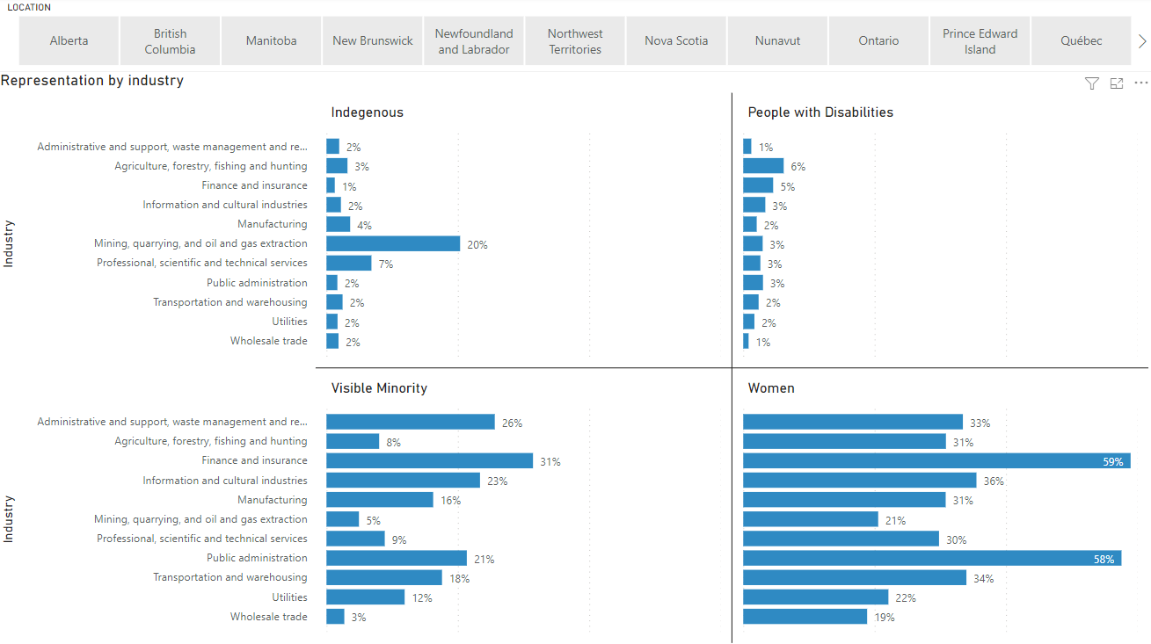
What can employers do? (1/2)
Managers can identify the gap and see how they can reduce barriers (not lower the bar) to increase diversity.
We have created a tool that can help employers identify opportunities to increase diversity.

Slide 5
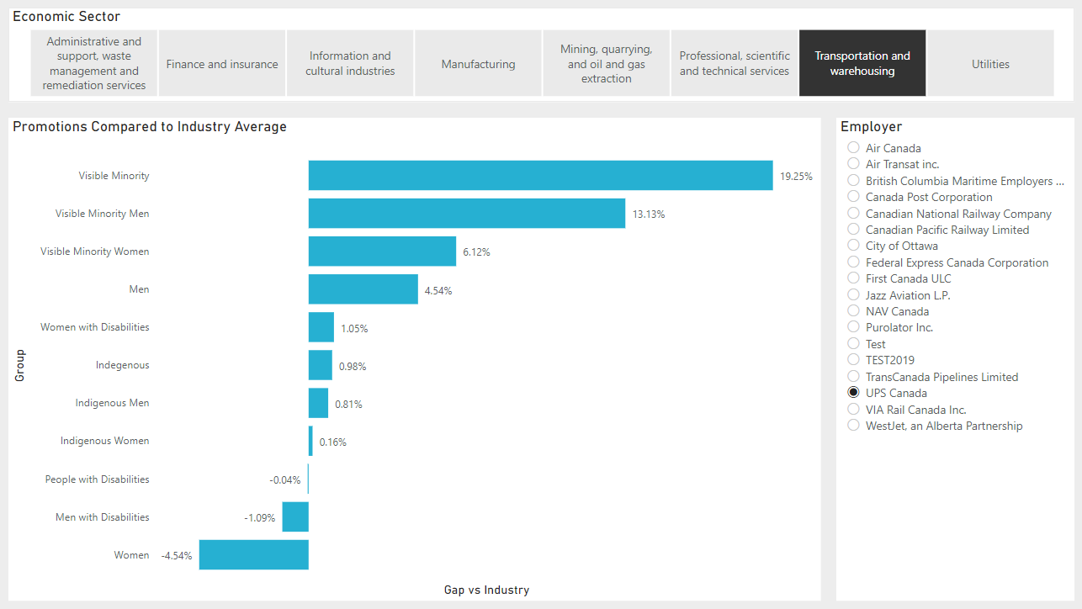
What can employers do? (2/2)
See how they compare to other employers in the industry and reach out to underrepresented groups for hiring opportunities

Slide 6
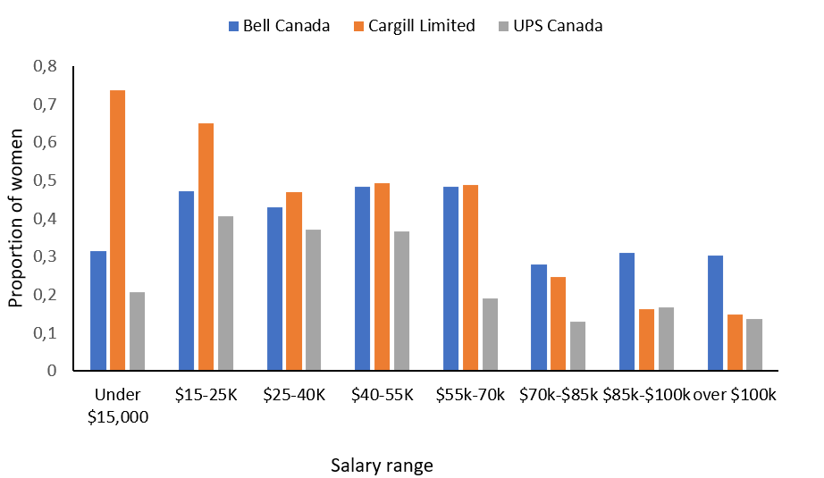
What can employers do?
We suggest that employers take a look at the distribution of the salary within each group.

Slide 7
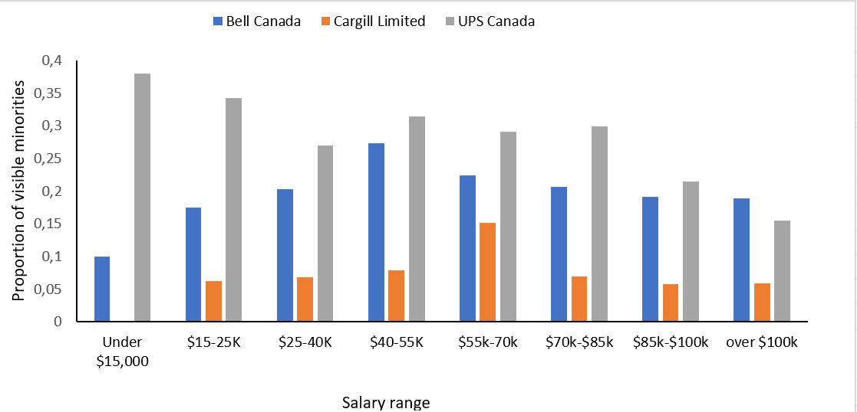
Another example
We observe a more fairly distribution of the salary for the Visible minorities group in these 3 entreprises

Slide 8
R Shiny interface
How R shiny was used to created an interactive dashboard for the client and provided additional information on the hiring and termination trends of the company and its sector.

Slide 9
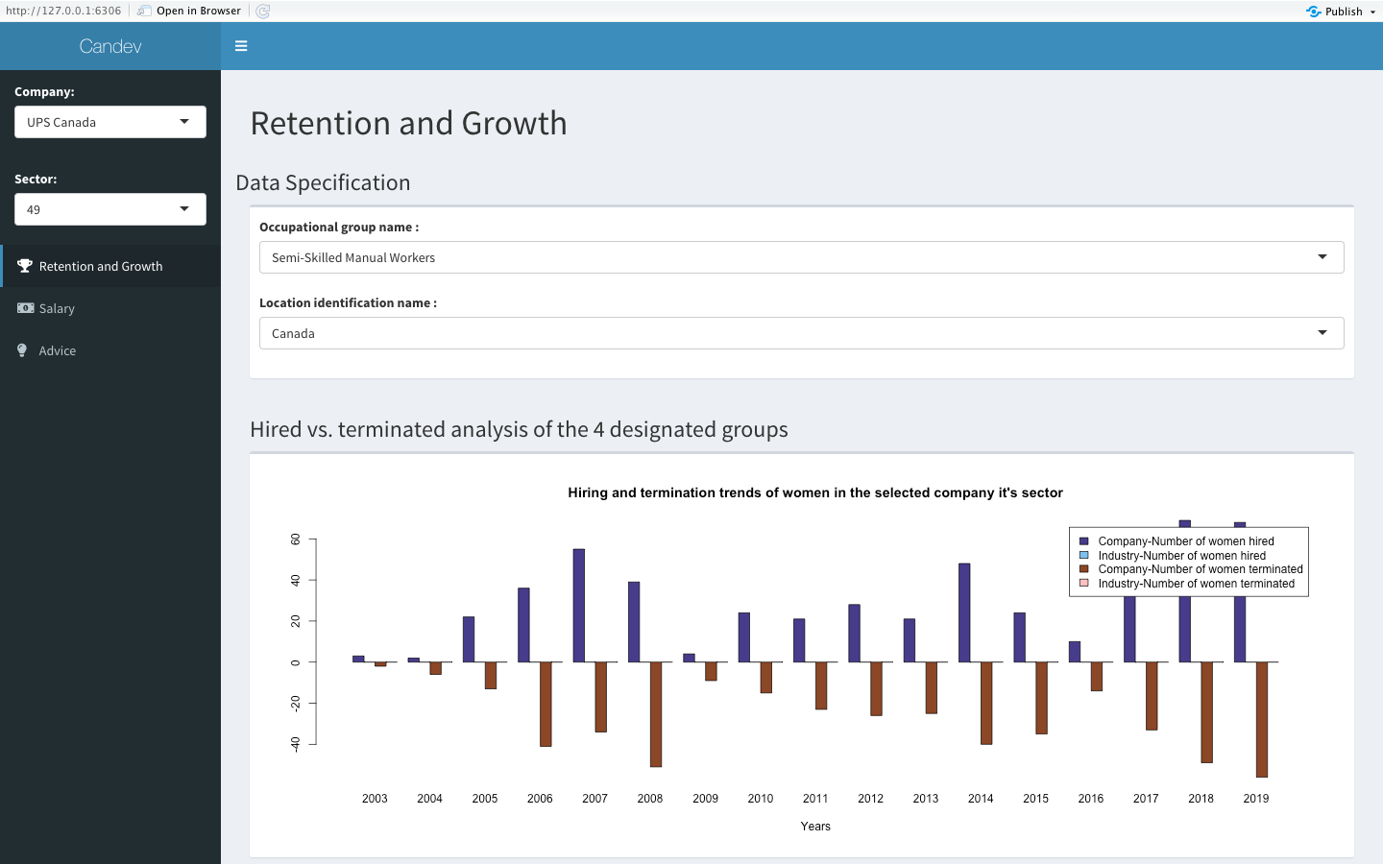

Slide 10
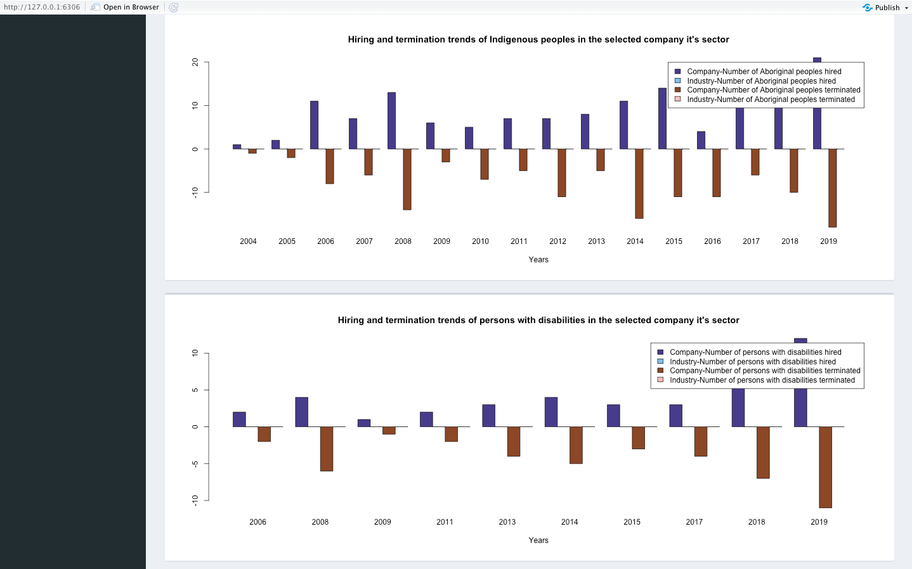

Slide 11
